Slide 1



IBM Research hosting Harvard Medical School (March 2019)
Kingsfield: ”Through this method of questioning, answering... questioning, answering... we seek to develop in you the ability to analyze... that vast complex of facts that constitute... the relationships of treatments, covariates, and outcomes within a given electronic medical database... ”

Slide 2
Schedule
Guest lectures
Florence, an IBM Master Inventor and a senior architect, will share her extensive experience in inventing.
FX will share of his extensive experience as a physician, working also for start-ups and with IBM Research and Watson Health.
Yoonyoung, a Harvard graduate, will give an introductory overview of a variety of statistical approaches.
Use the “Right Heart Catheterization Dataset” made available by Vanderbilt university
Team 1: Is “right heart catheterization” beneficial to patients? Is it beneficial to certain patients but harmful to others?
Team 2: Is “right heart catheterization” beneficial to patients? Explore “confounding” (one of the most common biases in observational databases).
Introduction to R using EMRBots
Introduction to electronic medical records
What are EMRs and what is valuable about them? Go through several use cases.
March 5
March 7
March 12
Next lectures
Disrupting medicine using electronic medical records

Slide 3
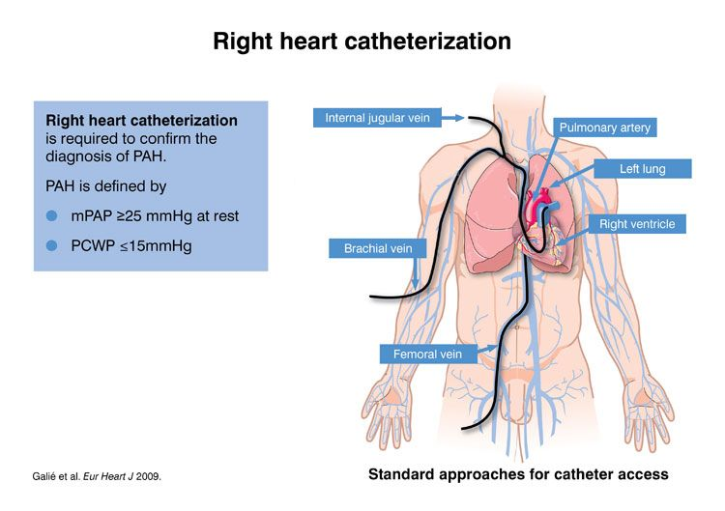
What is heart catheterization?
Watch video: https://www.youtube.com/watch?v=tD4jtwHMliQ
Notes:
Right Heart Catheterization in Pulmonary Arterial Hypertension (PAH): Dr. Roham Zananian, Accosiate Professor of Pulmonary Medicine and Director of the Adult PH Service at Stanford discusses right heart catheterization for pulmonary arterial hypertension (PAH).

Slide 4
Right heart catheterization data
Database to exercise is publicly available at:
http://biostat.mc.vanderbilt.edu/wiki/Main/DataSets or at
https://github.com/kartoun/IBM-Harvard-Workshop
ICU patients in 5 hospitals.
Treatment: right heart catheterization (RHC) vs. not.
Outcome: death (yes/no).
Confounders: demographics, insurance, disease diagnoses, etc.
2184 treated and 3551 controls.

Slide 5
Project: Is RHC beneficial to patients?
Team 1
Sub-population exploration
Team 2
Confounding exploration
Explore:
If you use all available covariates, will the conclusion (e.g., RHC is beneficial) change if you select only say half of the covariates?
Are there specific covariates that may change the conclusion regarding the benefit (or harm) of going through the RHC procedure?
Your own questions…
Explore:
Is RHC beneficial to certain patients but harmful to others?
If it is harmful to certain populations then what does characterize such populations?
Your own questions…

Slide 6
Randomized trials
In a randomized trial, treatment assignment would be determined by a coin toss – effectively erasing the link between the covariates to the treatment assignment.
Randomization
Observational
Covariates
Covariates
Treatment
Outcome
Treatment
Outcome

Slide 7
Why not always randomize?
Randomized trials are expensive.
Randomizing treatment / exposure may be unethical.
It is not guaranteed that all initial participants will complete their participation in a randomized trial.
Randomized trials are long as they require waiting for outcome data.

Slide 8
Observational studies
Passive data collection:
Electronic medical records, claims, registries.
Large sample sizes; inexpensive, potential for rapid analysis.
Data quality typical lower, no uniform standard of collection.
Like trials: data collected on a common set of variables at planned times; outcomes carefully measured; study protocols.
Different than trials:
Regulations are much weaker.
Broader populations are eligible for a study.

Slide 9
Matching
Matching is a method that attempts to make an observational database more like a randomized trial.
Main idea:
Match individuals in the treated group to individuals in the control group using a set of covariates.

Slide 10
Let’s practice R…
Download the RHC data and R code.
https://github.com/kartoun/IBM-Harvard-Workshop
Folder: “Right heart catheterization dataset”.
Use the code to:
Import the data.
Match cases and controls.
Assess treatment effect of RHC on mortality.
Explore the data according to each team’s research question(s).
Notes:
https://www.coursera.org/learn/crash-course-in-causality
https://www.coursera.org/learn/crash-course-in-causality/home/week/3

